Slide 1
Permanent Magnet Synchronous Motor control
21/06/2024
Daniel Montesinos-Miracle (daniel.montesinos@upc.edu)
Oriol Subirats-Rillo (oriol.subirats.rillo@upc.edu)

Slide 2
Agenda
 | TEMA – CONTENIDO | MATERIAL DE ESTUDIO – METODOLOGÍA
Duración: 1 h Prof.: Daniel Montesinos | Introducción. Generación de par. Motor DC como ejemplo Motores PMSM (o BLAC) y BLDC. Fuerza contraelectromotriz | Sesión teórica para introducir las bases de la generación de par en máquinas eléctricas rotativas y presentar las estrategias de control de este tipo de máquinas. Ejemplo del motor DC. Diferencias entre BLDC y PMSM.
Duración: 3 h Prof.: Daniel Montesinos | Modelado y control del motor PMSM. | Sesión teórica-práctica para abordar los aspectos del modelado y estrategias de control del motor PMSM. En la práctica se implementará el modelo y el control de par y velocidad del motor PMSM usando la herramienta PLECS.
Duración: 2 h Prof.: Daniel Montesinos/Oriol Subirats | Convertidores para motores PMSM. Estrategias de modulación | Sesión teórica-práctica para presentar las distintas estrategias de modulación para motores PMSM. En la práctica se implementará una de las estrategias de modulación como proceso incremental del modelado del sistema iniciado en la sesión anterior.
Duración: 2 h Prof.: Oriol Subirats | Operación en la zona LBEF. Operación en la zona FW | Sesión teórica-práctica en la que se desarrolla el modelo para analizar los puntos de trabajo del motor y seguidamente se analiza la operación en la zona LBEF y FW. En la parte práctica se implementará en el modelo de simulación incremental la operación en la región de operación en Field-Weakening
Duración: 1 h Prof.: Oriol Subirats | Obtención práctica de parámetros de un motor PMSM | En esta sesión se explicará cómo se pueden obtener los parámetros del motor PMSM necesarios para el diseño de un sistema de control FOC.
Duración: 1 h Prof.: Oriol Subirats | Aspectos para el control digital de convertidores | Sesión teórica en donde se darán las indicaciones básicas para la implementación de controladores digitales para convertidores de potencia.

Slide 3
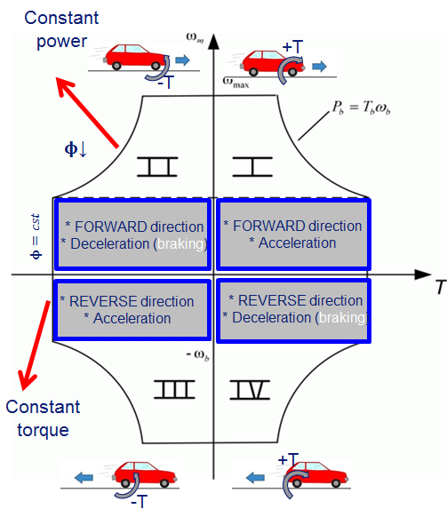
Mechanical system to control
Main objective: desired position/speed/torque profile
Secondary objectives
Load, drive and people protection
Reliability, robustness

Slide 4
Energy flow
Traction phase
Braking phase

Slide 5
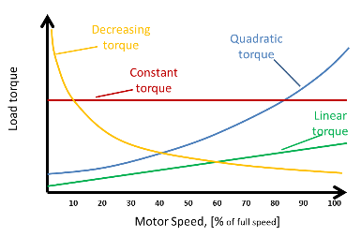
Types of loads
Constant torque: hoist, tyre friction, weight
Linear load: compressor
Quadratic load: fan, wind turbine, air friction
Constant power: winder
$$T_{L}=ct. P∝ω$$
$$T_{L}∝ω P∝ω^{2}$$
$$T_{L}∝ω^{2} P∝ω^{3}$$
$$T_{L}∝\frac{P}{ω} P=ct.$$

Slide 6
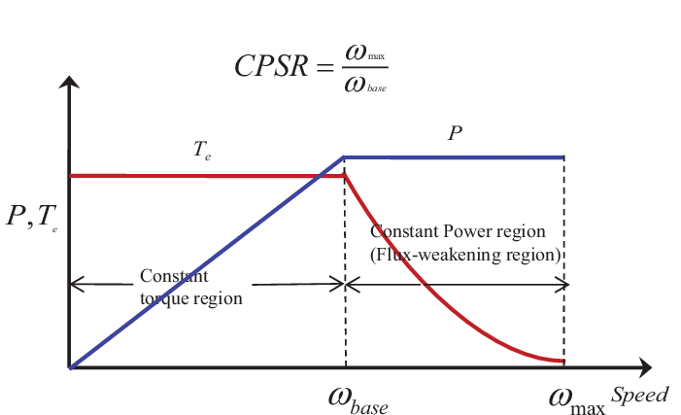
Ideal power plant
Constant power profile over speed
Limited torque at low speeds due to maximum tractive effort, maximum current
Limited speed due to mechanical or electrical limitations
Constant torque during rotation to avoid vibration, noise and fatigue
$$P=Γω$$

Slide 7
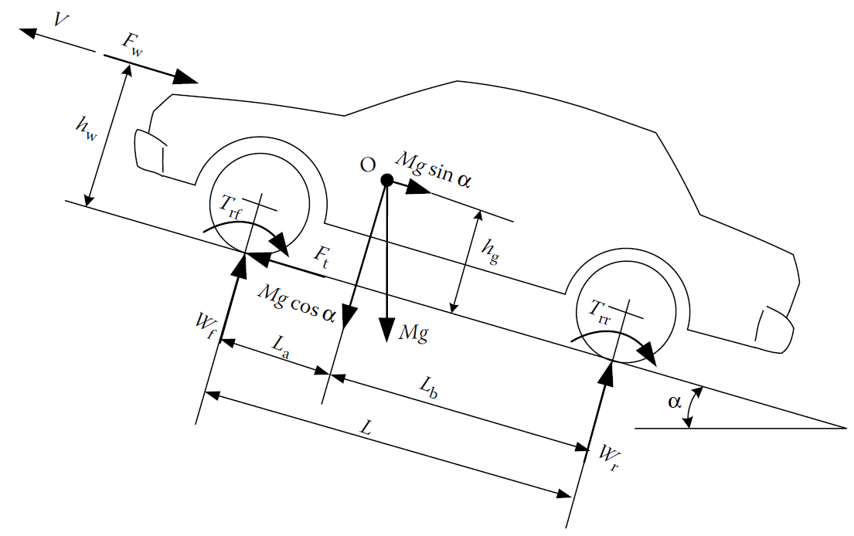
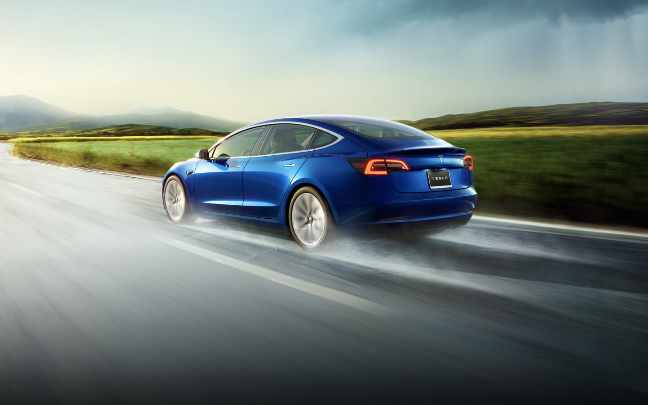
Forces in a vehicle
F_{a}: aerodynamical drag
F_{r}: Rolling friction
F_{g}: weight
F_{t}: tractive force
m$a=F_{t}−\left(F_{a}+F_{r}+F_{g}\right)$

Slide 8
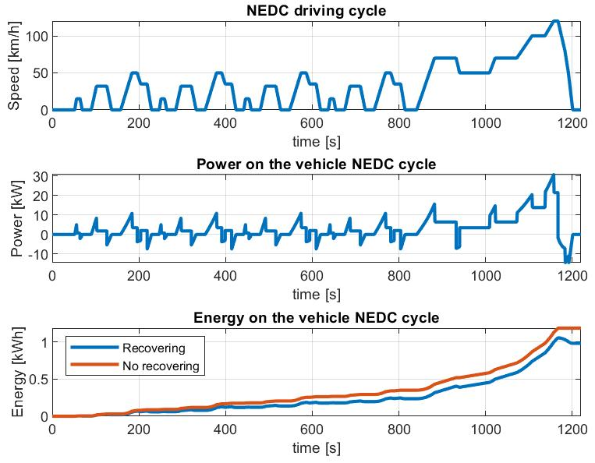
NEDC driving cycle

Slide 9
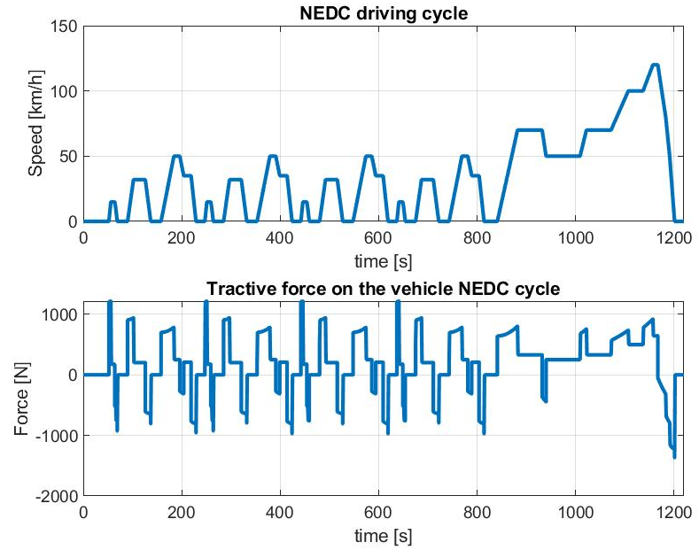
Driving profile – force profile

Slide 10
Lab0. VEHICLE MODEL

Slide 11
Forces in a vehicle
F_{a}: aerodynamical drag
F_{r}: Rolling friction
F_{g}: weight
F_{t}: tractive force
m$a=F_{t}−\left(F_{a}+F_{r}+F_{g}\right)$

Slide 12
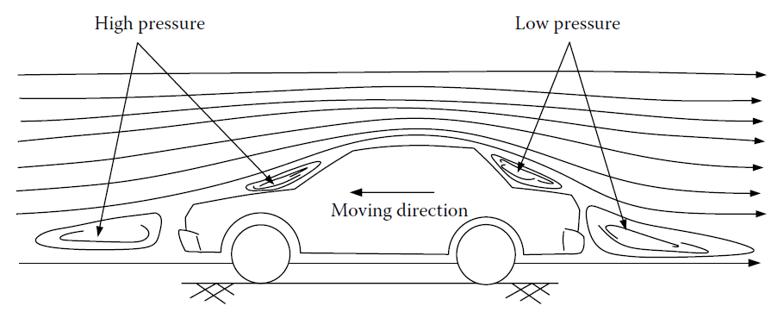
Aerodynamic friction losses
Two origins
Viscous friction of surrounding air
Pressure difference in front and rear
ρ: air density
A_{f}: frontal area
c_{d}: aerodynamic drag coefficient
V: vehicle speed
V_{w}: wind speed

Slide 13
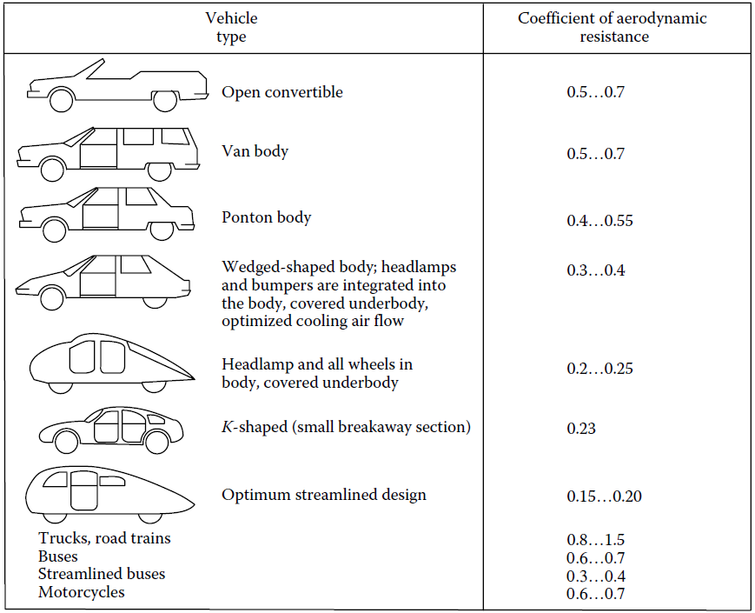
Aerodynamic drag coeficient

Slide 14
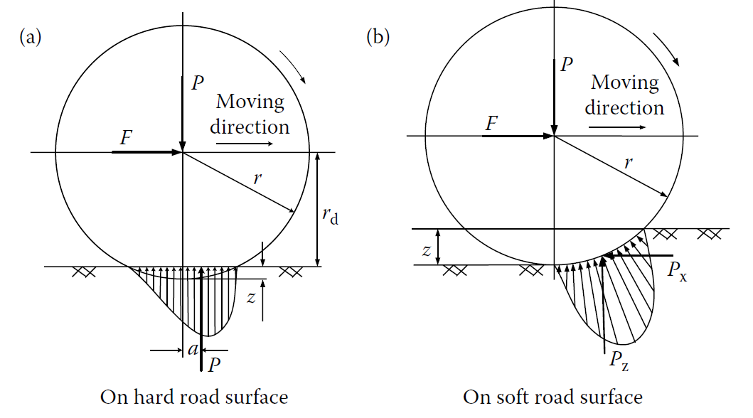
Rolling friction
Due to hysteresis of tire material

Slide 15
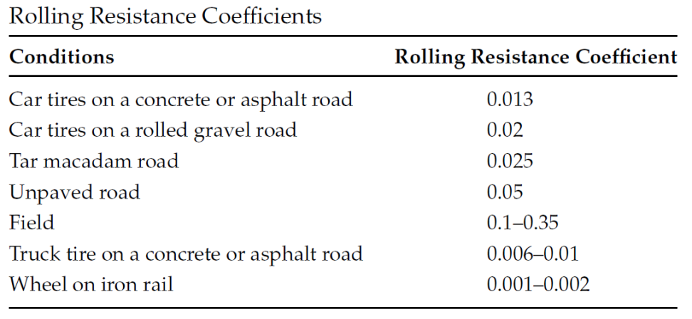
Rolling friction
Depends on many factors: vehicle speed, tyre pressure, road surface conditions
f_{r}: rolling friction coefficient
M: vehicle mass
g: gravity constant
α: road slope
Accepted speed dependence for most situations

Slide 16
Hill climbing force
Conservative
Great influence on vehicle dynamics
M: vehicle mass
g: gravity constant
α: road slope

Slide 17
Parameters
Environment
Vehicle
Parameter | Value
Vehicle mass (m_{v}) | 150 kg
Drag coeficient (C_{d}) | 0,85
Frontal area (A_{f}) | 0,4 m²
Rolling resistance coeficient (f_{r}) | 0,025
Tyre effective rolling radius (r_{w}) | 0,06 m
Reduction gear (k_{gear}) | 10
Parameter | Value
Air density (ρ) | 1,22521 kg/m³
Gravity constant (g) | 9,8 m/s²
Air speed | 0 m/s
Grade | 0 %

Slide 18
DC motor

Slide 19
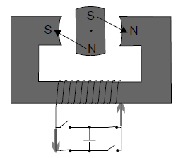
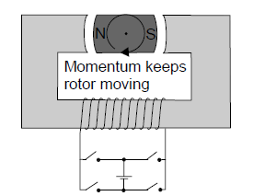
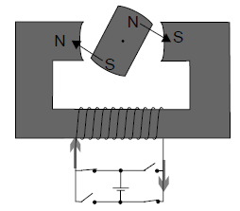
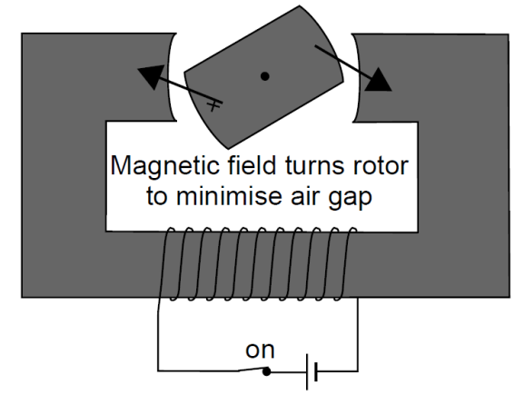
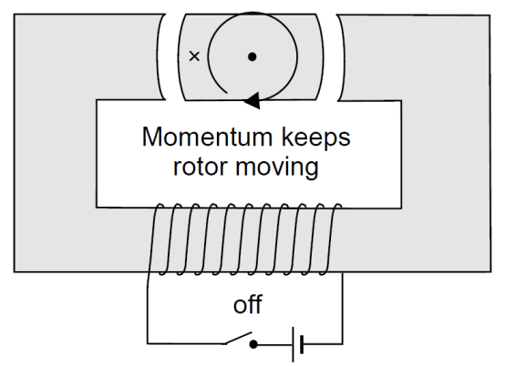
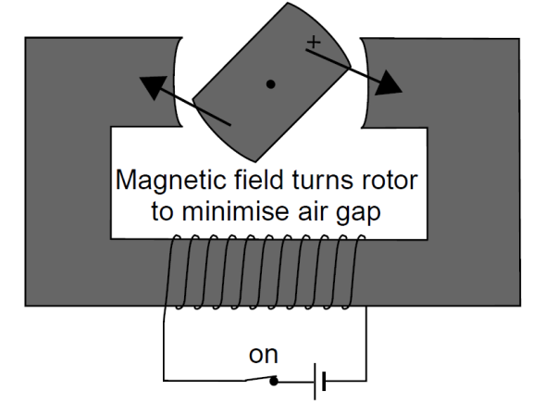
Torque production

Slide 20
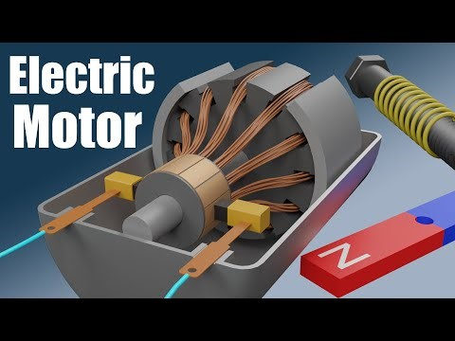
Torque production. DC motor
https://www.youtube.com/watch?v=CWulQ1ZSE3c

Slide 21
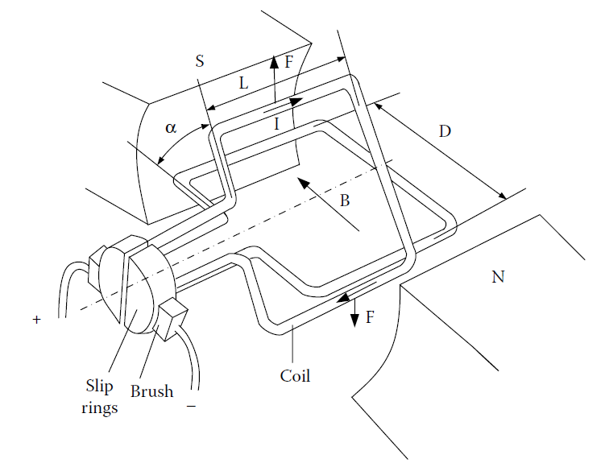
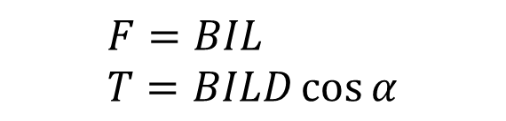
DC motor torque production
On a wire carrying electric current placed in a magnetic field (armature), a magnetic force acting on the wire is produced
$$F=BIL \\ T=BILD\cos{α}$$

Slide 22
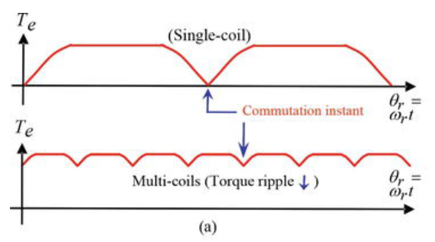
Effect of the number of windings
$$\frac{ΔT}{T_{pk}}=1−\cos\left(\frac{π}{N_{b}}\right)$$

Slide 23
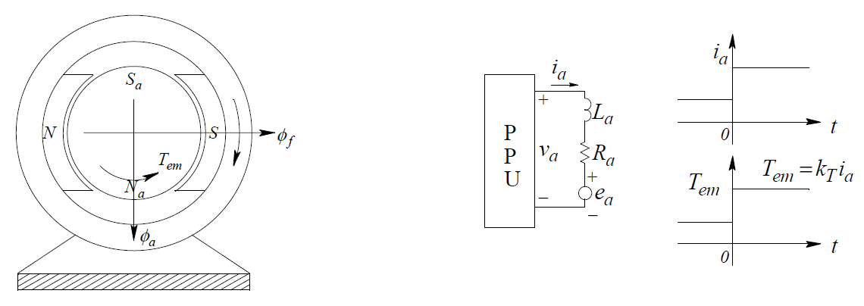
Constant torque

Slide 24
Back electromotive force
A variable time flux linkage induces a voltage in a winding (back emf). Lenz or Faraday law

Slide 25
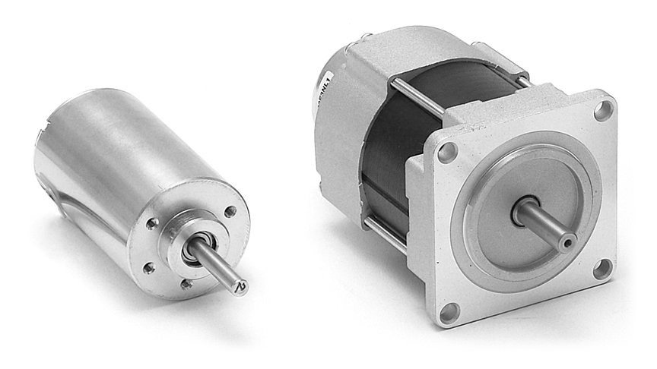
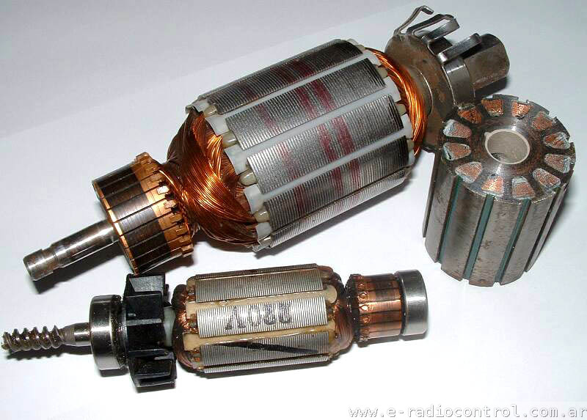
DC motors
Easy to control torque/speed
Widely known
Low-cost
Low power (200 W)
Low efficiency (70 %)
High maintenance (brushes)

Slide 26
DC motor dynamic model and equations

Slide 27
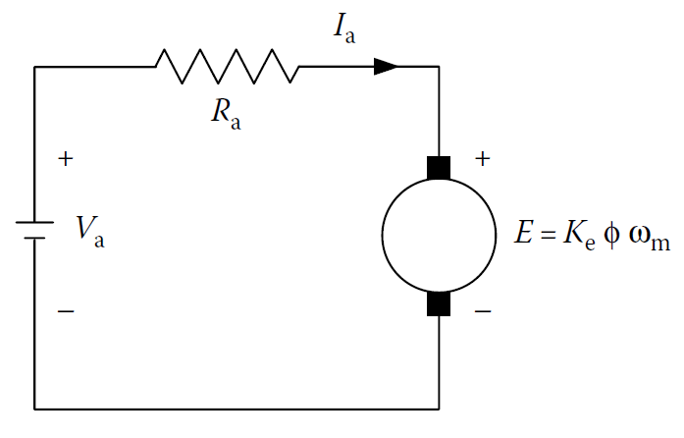
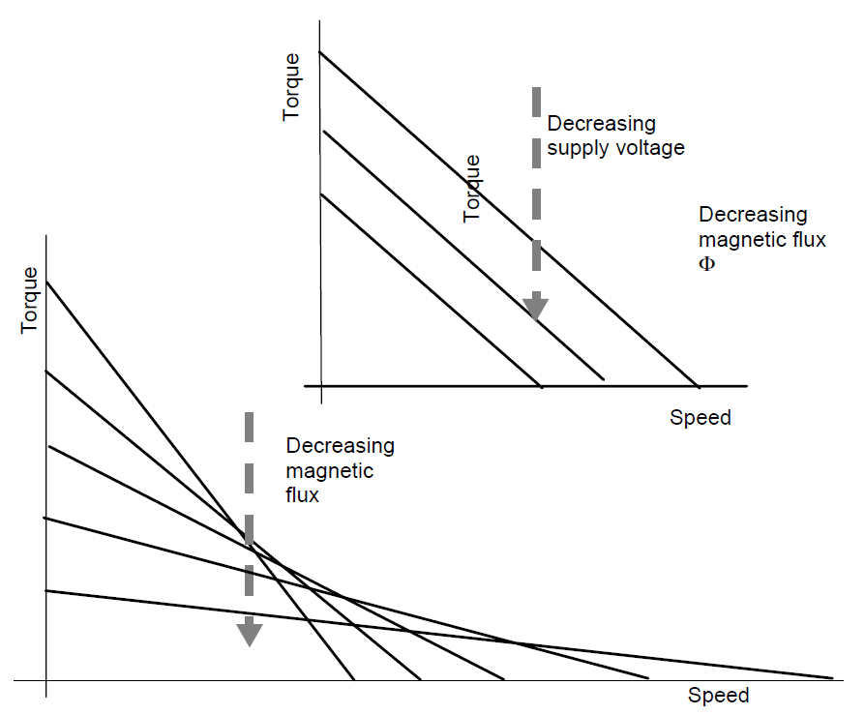
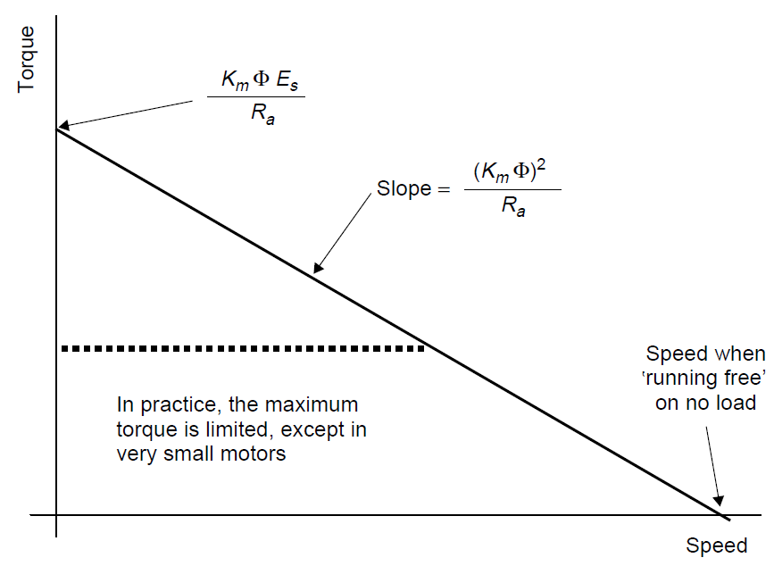
DC steady state motor model and equations

Slide 28
Example
DC motor parameters
Speed, current and torque performance

Slide 29
Operating points – steady state

Slide 30
Operating points – steady state

Slide 31
Heat and thermal characteristics
$$\left\{\begin{aligned}P_{l}=P_{c}\text{+ }P_{a} \\ P_{c}=C_{th,m}·\frac{dT_{m}}{dt} \\ P_{a}=\frac{T_{m}−T_{a}}{R_{th,m−a}}\end{aligned}\right.$$
$P_{l}=C_{th,m}·\frac{dT_{m}}{dt}\text{+}\frac{T_{m}}{R_{th,m−a}}$-$\frac{T_{a}}{R_{th,m−a}}$
$$T_{m}=\int{\frac{dT_{m}}{dt}}·dt=\int{\frac{1}{C_{th,m}}}·\left(P_{l}−\frac{T_{m}}{R_{th,m−a}}+\frac{T_{a}}{R_{th,m−a}}\right)dt$$

Slide 32
Heat and thermal characteristics

Slide 33
Safe Operating Area
4
3
t = 1’
Commutation limit
2
t = 20’
t = 60’
1
Continuos Duty
1
2
The maximum torque, current or power can be limited by the converter

Slide 34
control

Slide 35
DC motor dynamic model and equations

Slide 36
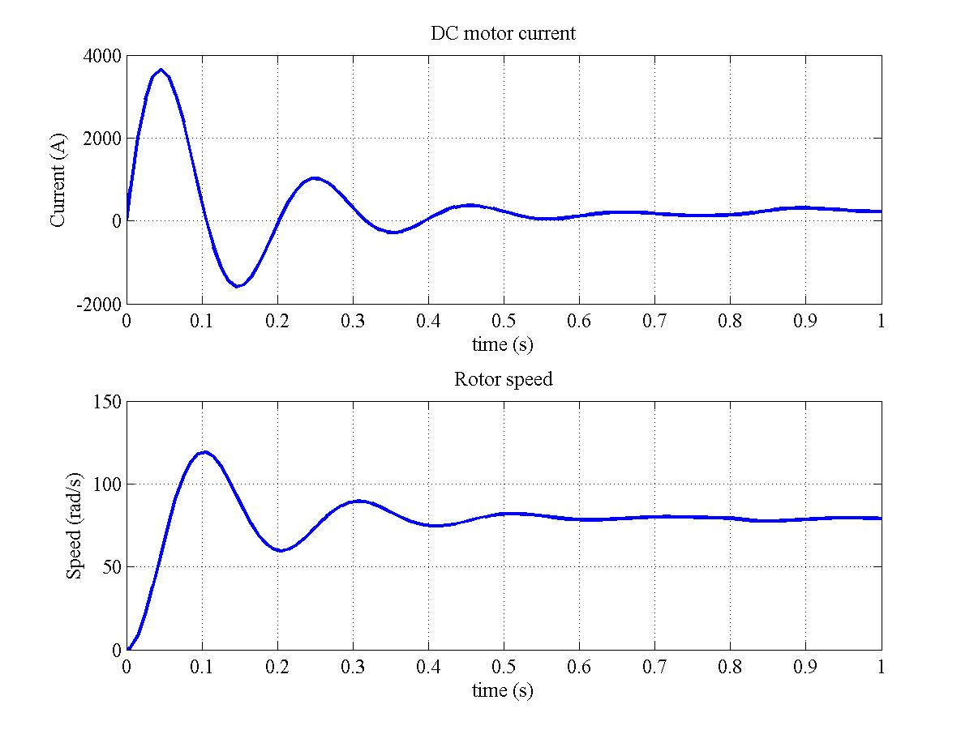
Step response
Values
U_{a} = 300 V
T_{L} = 372 Nm
J = 7,12 kg m²
b = 7,2 N s rad⁻¹
R_{a} = 25 mΩ
L_{a} = 2 mH
K = 3,72 V·s/rad

Slide 37
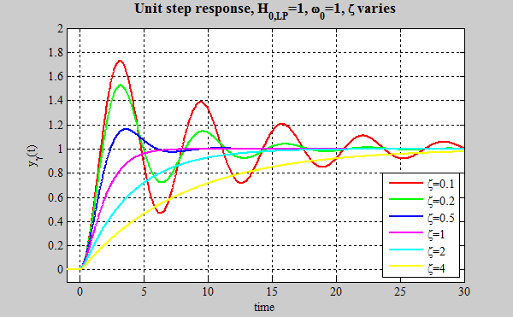
Closed loop system

Slide 38
Controller tuning

Slide 39
Internal Model Control
t_{r} is the settling time from 10% to 90%
K_{p} and K_{i} impose these dynamics in a first-order system
t_{r}

Slide 40
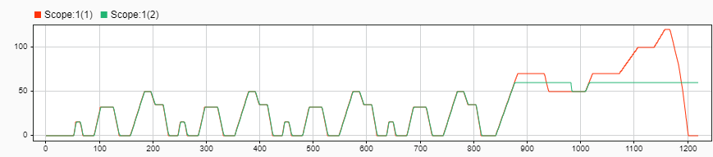
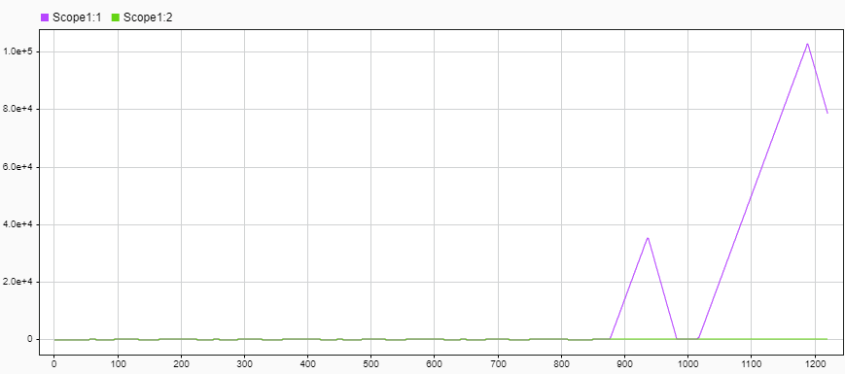
PI saturation
The output of the current PI controller is the voltage to be applied to the motor
The motor voltage is limited to protect the motor, but limits the maximum speed
And the integrator continues to integrate the error
Anti wind-up to reset faster the saturated integrator output

Slide 41
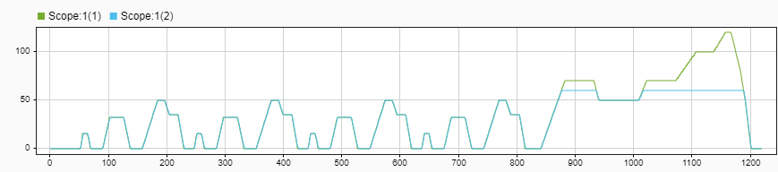
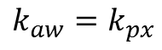
Anti wind-up PI controller
$$k_{aw}=k_{px}$$

Slide 42
Power Electronics for DC motor

Slide 43
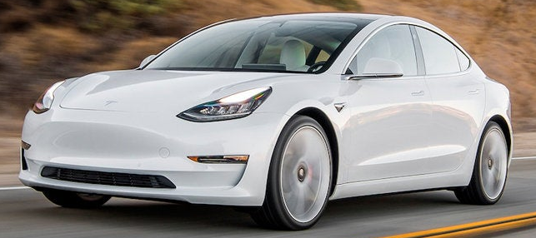
4 quadrant converter
Now the car accelerates and brakes in both senses

Slide 44
Basic equations
$$\frac{\left\langle U_{s}\right\rangle }{U_{e}}=\frac{E_{s}}{U_{e}}=2D−1=α \\ 0≤D≤1;−1≤α≤1 \\ \frac{\left\langle I_{e}\right\rangle }{\left\langle I_{s}\right\rangle }=2D−1=α \\ ΔI_{s}=\frac{U_{e}}{L_{s}f}2D\left(1−D\right)$$

Slide 45
Lab1. DC motor model and control

Slide 46
Motor parameters Maxon RE 65, 250 W, 48 V
Parameter | Value
Rated power (P) | 250 W
Rated voltage (V) | 48 V
Rated current (A) | 6,8 A
Rated speed (rpm) | 3420 rpm
Maximum speed (rpm) | 6000 rpm
EMF constant (k_{Φ}) | 77,8 rpm/V
Winding resistance (r_{a}) | 0,365 Ω
Winding inductance (L_{a}) | 0,161 mH

Slide 47
Ac motors

Slide 48
AC brushless motors

Slide 49
Constant torque

Slide 50
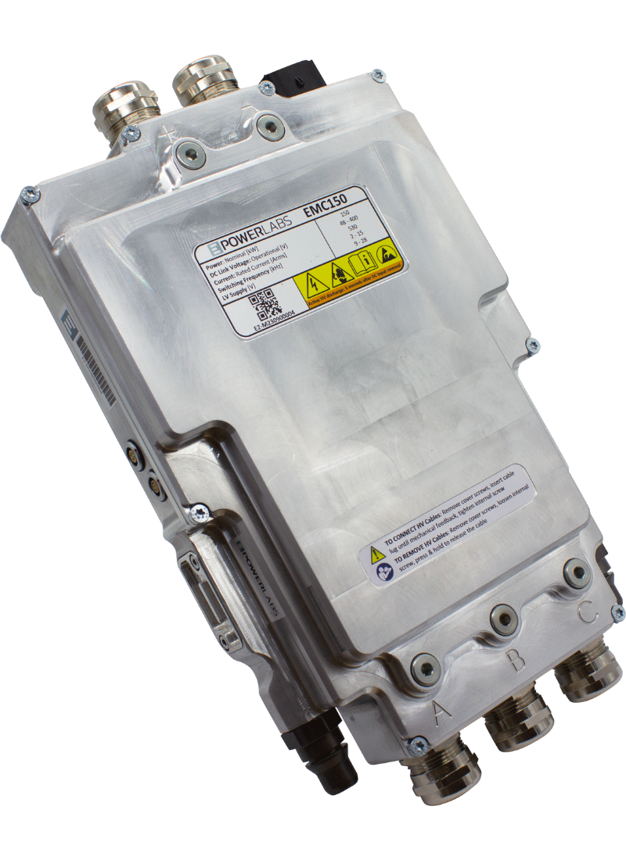
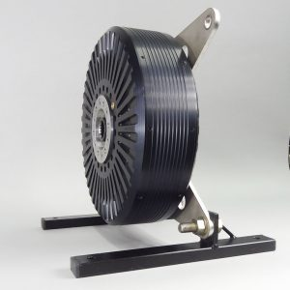
AC motors
Higher power ( +100 kW)
Low-maintenance (no brushes)
Higher efficiency ( 98 %)
Internal o external rotor
Rare earth magnets
More complex control
Needs position sensor
Needs for power electronics

Slide 51
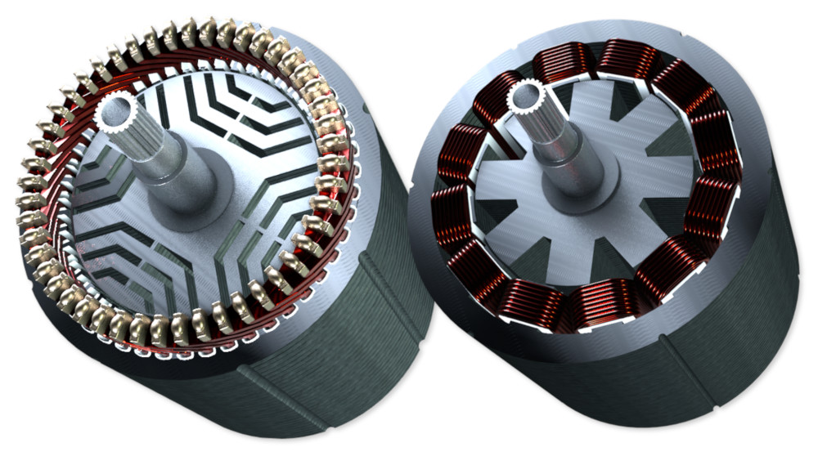
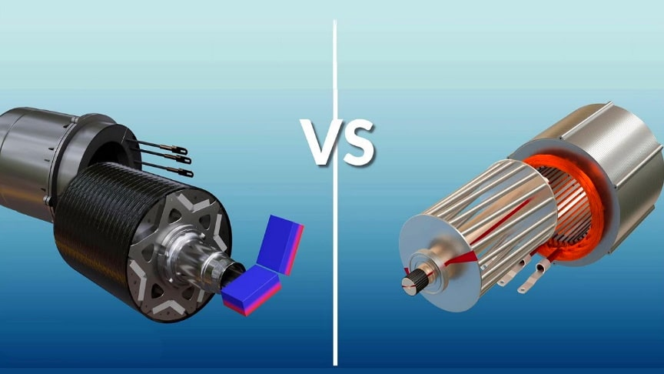
AC motors
Used for traction or high power
Mainly two types: PMSM and Induction
Also synchronous reluctance motor (SyncRel) and Switched Reluctance Motor
Need of power electronics and complex control

Slide 52
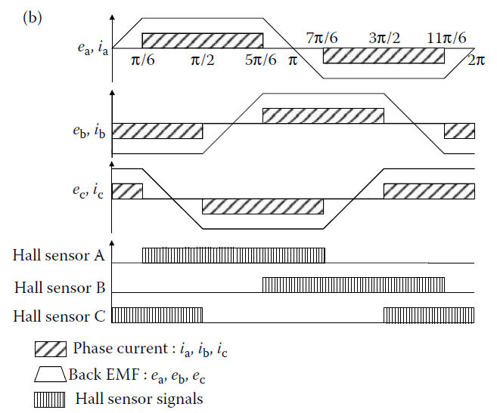
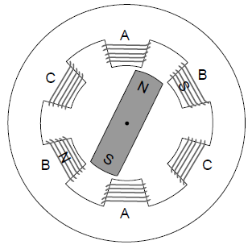
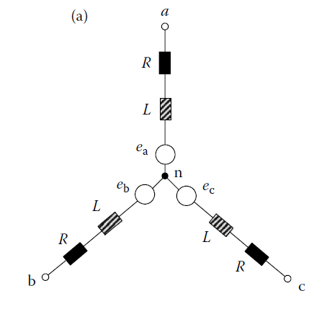
Brushless DC motor

Slide 53
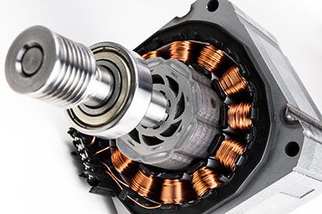
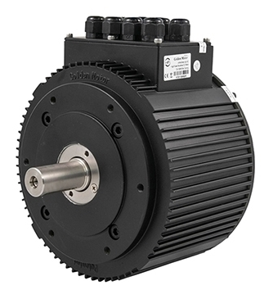
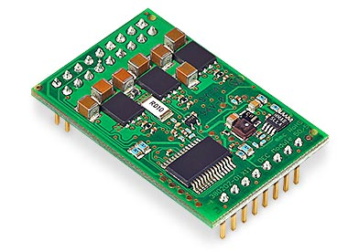
Brushless DC motors
Higher power ( 10 kW)
Low-maintenance (no brushes)
Higher efficiency ( 90 %)
Internal o external rotor
Many shapes
Rare earth magnets
More complex control
Needs position sensor
Needs for power electronics

Slide 54
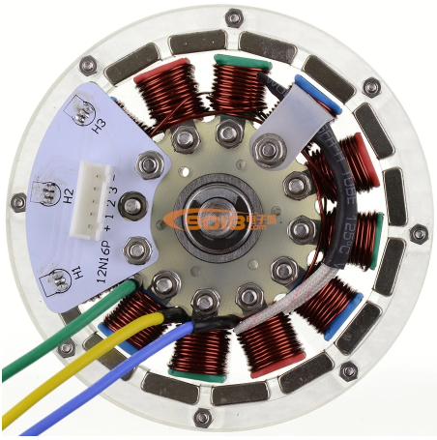

Slide 55
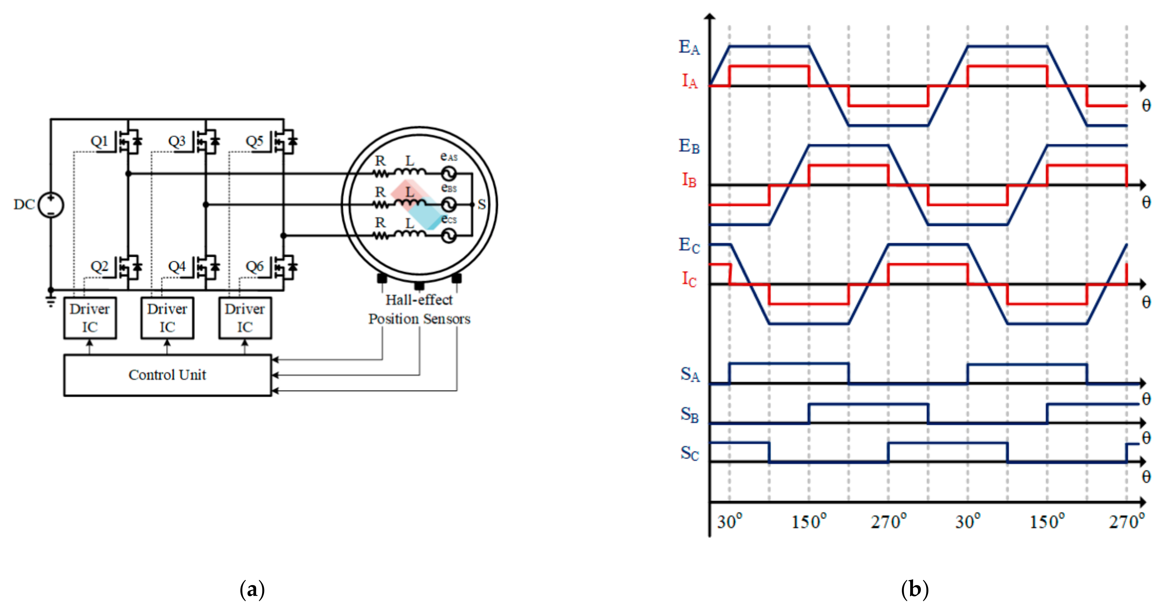
Three phase inverter
Only two phases are used. The third phase is led unconnected (open switches)
Standard PWM as a DC motor
No current on the unconnected phase. Voltage = bemf. Sensorless methods are based on measuring this phase voltage

Slide 56
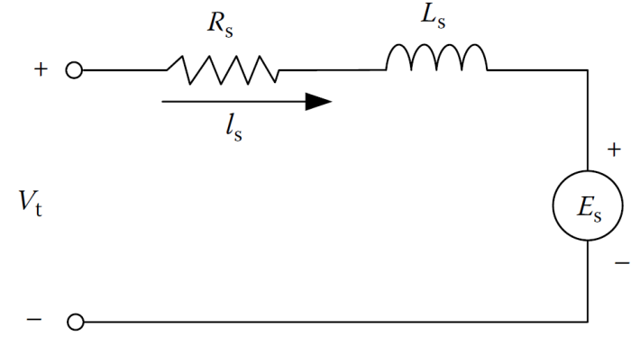
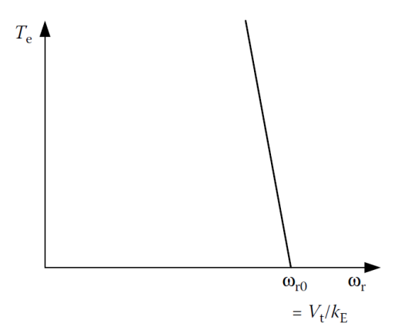
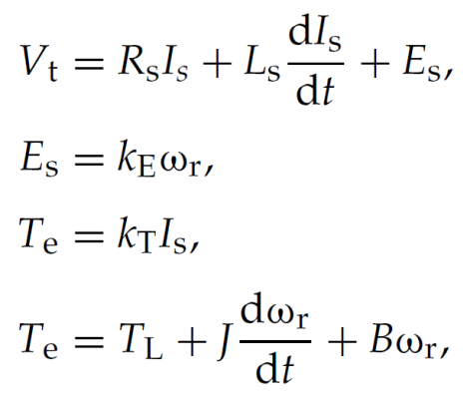
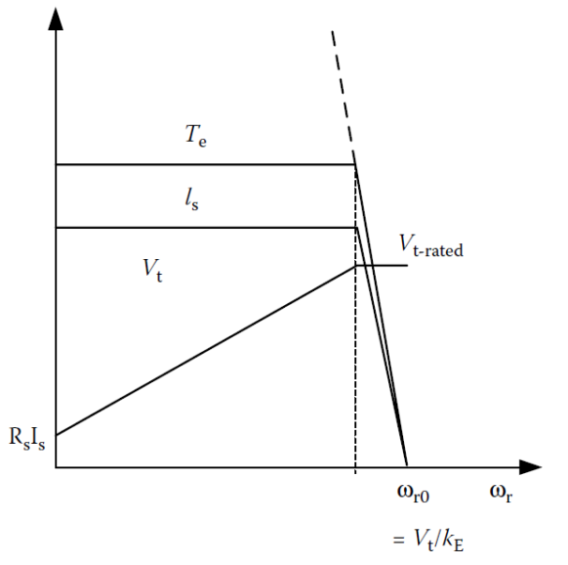
Model and control of BLDC motors
As three equal DC motors
The model can be seen as a DC motor
Not using the full power capability of three phases

Slide 57

Control of BLDC motors
The control is similar to a DC motor, but the commutation sequencer decides which of the two phases have to be excited. Synchronous motor

Slide 58
Permanent Magnet Synchronous Motors - PMSM
Three sinusoidal distributed windings
Spatial shifted 120º
The magnet flux generates three sinusoidal voltages 120º in phase
No thermal effect on windings and magnet
No saturation on inductances

Slide 59


Constant torque required
The magnet flux rotates with the rotor
To produce a constant torque, the stator flux must rotate at the same speed as rotor -> synchronous

Slide 60

Sinusoidal currents
The stator flux must rotate
Three sinusoidal currents in stator

Slide 61

Classification of permanent magnet synchronous motors
o BLAC

Slide 62











Classification of PMSM
$$L≈\frac{N^{2}}{ℜ}$$
Inductance equation:
$$μ_{r,air}≈1$$
$$μ_{r,steel}≈2000$$
$$ℜ=\frac{l}{μ·A}$$
$μ_{r,magnet}≈1,05$(Neodymium)
Reluctance equation:
SPMSM
IPMSM
Radially magnetized
IPMSM
Tangentially magnetized
$$ℜ_{d}≈ℜ_{q}$$
$$ℜ_{d}>ℜ_{q}$$
$$ℜ_{d}<ℜ_{q}$$
$$L_{d}≈L_{q}$$
$$L_{d}<L_{q}$$
$$L_{d}>L_{q}$$
Rotor cross-section of different sinusoidal permanent magnet synchronous machines.

Slide 63


Slide 64
Performance of PMSM
Higher power (density) ( +100 kW)
Low-maintenance (no brushes)
Higher efficiency ( 98 %)
Internal or external rotor
High torque/inertia
High reliability
Rare earth magnets. High cost
More complex control
Needs position sensor
Needs for power electronics

Slide 65
Permanent Magnet Synchronous Motors - PMSM
Three sinusoidal distributed windings
Spatial shifted 120º
The magnet flux generates three sinusoidal voltages 120º in phase
No thermal effect on windings and magnet
No saturation on inductances

Slide 66
Electrical equations

Slide 67
Electrical equations

Slide 68
Electrical equations

Slide 69

Electrical equations
$$L_{A}={\left(\frac{N_{s}}{2}\right)}^{2}πμ_{0}rlε_{1} \\ L_{B}=\frac{1}{2}{\left(\frac{N_{s}}{2}\right)}^{2}πμ_{0}rlε_{2} \\ ε_{1}=\frac{1}{2}\left(\frac{1}{g_{\min{}}}+\frac{1}{g_{\max{}}}\right)\text{; }ε_{2}=\frac{1}{2}\left(\frac{1}{g_{\min{}}}−\frac{1}{g_{\max{}}}\right)$$

Slide 70

Classification of PMSM
$$L_{A}={\left(\frac{N_{s}}{2}\right)}^{2}πμ_{0}rlε_{1} \\ L_{B}=\frac{1}{2}{\left(\frac{N_{s}}{2}\right)}^{2}πμ_{0}rlε_{2} \\ ε_{1}=\frac{1}{2}\left(\frac{1}{g_{\min{}}}+\frac{1}{g_{\max{}}}\right)\text{; }ε_{2}=\frac{1}{2}\left(\frac{1}{g_{\min{}}}−\frac{1}{g_{\max{}}}\right)$$

Slide 71
Electrical equations

Slide 72
Electrical equations
Non-linear differential system
Some terms depend on the angle
Difficult to compute the torque
No able for analysis

Slide 73
Constant torque required
The magnet flux rotates with the rotor
To produce a constant torque, the stator flux must rotate at the same speed as rotor -> synchronous

Slide 74
Sinusoidal currents
The stator flux must rotate (at the same speed of the rotor)
Three sinusoidal currents in the stator

Slide 75
Matrix transformations
i_{s} is a vector in a flat surface -> only two components needed (i_{α} and i_{β})
This is the Clarke transformation
Star connected motor and isolated neutral

Slide 76


Matrix transformations
Constant module (Clarke)
$$\left(\begin{matrix}i_{a} \\ i_{b} \\ i_{c}\end{matrix}\right)=\left(\begin{matrix}1 & 1 & 0 \\ 1 & \frac{−1}{2} & \frac{\sqrt{3}}{2} \\ 1 & \frac{−1}{2} & −\frac{\sqrt{3}}{2}\end{matrix}\right)\left(\begin{matrix}i_{0} \\ i_{α} \\ i_{β}\end{matrix}\right);{ }\left(\begin{matrix}i_{0} \\ i_{α} \\ i_{β}\end{matrix}\right)=\frac{2}{3}\left(\begin{matrix}\frac{1}{2} & \frac{1}{2} & \frac{1}{2} \\ 1 & \frac{−1}{2} & \frac{−1}{2} \\ 0 & \frac{\sqrt{3}}{2} & −\frac{\sqrt{3}}{2}\end{matrix}\right)\left(\begin{matrix}i_{a} \\ i_{b} \\ i_{c}\end{matrix}\right)$$
Orthogonal transformation. Maintains the instantaneous power (Concordia)
$$\left(\begin{matrix}i_{a} \\ i_{b} \\ i_{c}\end{matrix}\right)=\sqrt{\frac{2}{3}}\left(\begin{matrix}\frac{1}{\sqrt{2}} & 1 & 0 \\ \frac{1}{\sqrt{2}} & \frac{−1}{2} & \frac{\sqrt{3}}{2} \\ \frac{1}{\sqrt{2}} & \frac{−1}{2} & −\frac{\sqrt{3}}{2}\end{matrix}\right)\left(\begin{matrix}i_{0} \\ i_{α} \\ i_{β}\end{matrix}\right);{ }\left(\begin{matrix}i_{0} \\ i_{α} \\ i_{β}\end{matrix}\right)=\sqrt{\frac{2}{3}}\left(\begin{matrix}\frac{1}{\sqrt{2}} & \frac{1}{\sqrt{2}} & \frac{1}{\sqrt{2}} \\ 1 & \frac{−1}{2} & \frac{−1}{2} \\ 0 & \frac{\sqrt{3}}{2} & −\frac{\sqrt{3}}{2}\end{matrix}\right)\left(\begin{matrix}i_{a} \\ i_{b} \\ i_{c}\end{matrix}\right)$$

Slide 77


Clarke transformation
From a three-phase system at 120º in a flat surface to an orthogonal three-phase system
But, the transformed variables still depend on the angle
Clarke

Slide 78

Matrix transformations
i_{α} y i_{β} still depends on electrical rotor angle θ_{r}
To eliminate this dependence, α and β axes must turn with rotor flux
The rotating α and β axes are d^{r} and q^{r}
$$\left(\begin{matrix}i_{0} \\ i_{α} \\ i_{β}\end{matrix}\right)=\left(\begin{matrix}1 & 0 & 0 \\ 0 & \cos\left(θ\right) & −\sin\left(θ\right) \\ 0 & \sin\left(θ\right) & \cos\left(θ\right)\end{matrix}\right)\left(\begin{matrix}i_{0} \\ i_{d} \\ i_{q}\end{matrix}\right);{ }\left(\begin{matrix}i_{0} \\ i_{d} \\ i_{q}\end{matrix}\right)=\left(\begin{matrix}1 & 0 & 0 \\ 0 & \cos\left(θ\right) & \sin\left(θ\right) \\ 0 & −\sin\left(θ\right) & −\cos\left(θ\right)\end{matrix}\right)\left(\begin{matrix}i_{0} \\ i_{α} \\ i_{β}\end{matrix}\right)$$

Slide 79
Park transformation
Multiplying the two transformations

Slide 80

Matrix transformations
_{Clarke}
_{Rotation}

Slide 81


Park transformation
Constant module
$$\left(\begin{matrix}i_{a} \\ i_{b} \\ i_{c}\end{matrix}\right)=\left(\begin{matrix}1 & \cos{θ} & −\sin{θ} \\ 1 & \cos\left(θ−\frac{2π}{3}\right) & −\sin\left(θ−\frac{2π}{3}\right) \\ 1 & \cos\left(θ+\frac{2π}{3}\right) & −\sin\left(θ+\frac{2π}{3}\right)\end{matrix}\right)\left(\begin{matrix}i_{0} \\ i_{d} \\ i_{q}\end{matrix}\right);{ }\left(\begin{matrix}i_{0} \\ i_{d} \\ i_{q}\end{matrix}\right)=\frac{2}{3}\left(\begin{matrix}\frac{1}{2} & \frac{1}{2} & \frac{1}{2} \\ \cos{θ} & \cos\left(θ−\frac{2π}{3}\right) & \cos\left(θ+\frac{2π}{3}\right) \\ −\sin{θ} & −\sin\left(θ−\frac{2π}{3}\right) & −\sin\left(θ+\frac{2π}{3}\right)\end{matrix}\right)\left(\begin{matrix}i_{a} \\ i_{b} \\ i_{c}\end{matrix}\right)$$
$$p=v_{a}⋅i_{a}+v_{b}⋅i_{b}+v_{c}⋅i_{c}=\frac{3}{2}\left(v_{d}⋅i_{d}+v_{q}⋅i_{q}\right)$$
Orthogonal transformation. Maintains the instantaneous power
$$\left(\begin{matrix}i_{a} \\ i_{b} \\ i_{c}\end{matrix}\right)=\sqrt{\frac{2}{3}}\left(\begin{matrix}\frac{1}{\sqrt{2}} & \cos{θ} & −\sin{θ} \\ \frac{1}{\sqrt{2}} & \cos\left(θ−\frac{2π}{3}\right) & −\sin\left(θ−\frac{2π}{3}\right) \\ \frac{1}{\sqrt{2}} & \cos\left(θ+\frac{2π}{3}\right) & −\sin\left(θ+\frac{2π}{3}\right)\end{matrix}\right)\left(\begin{matrix}i_{0} \\ i_{d} \\ i_{q}\end{matrix}\right);{ }\left(\begin{matrix}i_{0} \\ i_{d} \\ i_{q}\end{matrix}\right)=\sqrt{\frac{2}{3}}\left(\begin{matrix}\frac{1}{\sqrt{2}} & \frac{1}{\sqrt{2}} & \frac{1}{\sqrt{2}} \\ \cos{θ} & \cos\left(θ−\frac{2π}{3}\right) & \cos\left(θ+\frac{2π}{3}\right) \\ −\sin{θ} & −\sin\left(θ−\frac{2π}{3}\right) & −\sin\left(θ+\frac{2π}{3}\right)\end{matrix}\right)\left(\begin{matrix}i_{a} \\ i_{b} \\ i_{c}\end{matrix}\right)$$
$$p=v_{a}⋅i_{a}+v_{b}⋅i_{b}+v_{c}⋅i_{c}=v_{d}⋅i_{d}+v_{q}⋅i_{q}$$

Slide 82
Park transformation of electrical motor equations

Slide 83
Park transformation of electrical motor equations

Slide 84
Park transformation of electrical motor equations
No angle dependent terms
Voltages and currents are DC values in steady state. Not sinusoids
Easy equation system
Easy to compute the produced torque

Slide 85
Equivalent equations and circuit

Slide 86
Produced torque expression

Slide 87
Torque properties
The torque depends only from machine parameters and currents
The torque is proportional to i_{ds} and i_{qs}
Two torques: magnet torque and reluctant torque

Slide 88
The complete model

Slide 89
Vector control
Torque expression for PMSM
Controlling and it is possible to control the current vector, the flux vector and the torque

Slide 90
Vector control of PMSM

Slide 91
Current control
Controls the current, controlling the produced torque
Direct limitation of current. Overload protections
Better dynamic performance
Low influence on parameter variation (r_{s}, L,…)
Compensation of voltage drops due to semiconductors and dead time
Compensation of DC bus fluctuations
Without amplitude and phase error
Commutation frequency constant or limited
Low current harmonic injection in the motor
Efficient user of DC bus voltage

Slide 92
Motor model and coupling terms
Currents and are DC values in steady state
But there is a cross coupling between d and q axes
It is not possible to independently control the currents
A variation on modifies and vice versa
That degrades the dynamic response
PI controllers can offer good performance, but decoupling is needed

Slide 93
Decoupling of torque loops

Slide 94
Speed loop
The mechanical system imposes the speed dynamics
The torque loop has a faster time constant
The torque loop is supposed to perfect control the required torque -> unitary gain

Slide 95
Complete scheme for vector control

Slide 96
Particular case: SPMSM
In an SPMSM L_{d}=L_{q}
The control strategy is to control i_{q} to control the torque and control i_{d}=0. It minimized losses.
No reluctant torque

Slide 97
inverters

Slide 98
Inverters. DC/AC converters
Connect a DC voltage source with an AC current source. Three-phase and single phase

Slide 99
Single phase inverter
Cell T1/T2 |  | Cell T3/T4 |  | Voltage u_{s}
T1 | T2 | T3 | T4
On | Off | On | Off | U_{e}
On | Off | Off | On | 0
Off | On | On | Off | 0
Off | On | Off | On | -U_{e}

Slide 100

Constant duty cycle modulation: two level
 | T1 | T2 | T3 | T4 | U_{A1} | U_{A2} | u_{s}
U_{cm}>u_{h} | On | Off | On | Off | U_{e} | 0 | U_{e}
U_{cm}<u_{h} | Off | On | Off | On | 0 | U_{e} | -U_{e}

Slide 101

Constant duty cycle modulation: three level
T1 | T2 | T3 | T4 | U_{A1} | U_{A2} | u_{s}
On | Off | Off | On | U_{e} | U_{e} | 0
On | Off | On | Off | U_{e} | 0 | U_{e}
Off | On | Off | On | 0 | U_{e} | -U_{e}
Off | On | On | Off | 0 | 0 | 0

Slide 102


Two level PWM modulation

Slide 103


Three level PWM modulation

Slide 104


Three level PWM modulation at double frequency

Slide 105
Three phase inverters
Connect a DC voltage source to an AC current source

Slide 106
Three phase inverter

Slide 107

Six step modulation

Slide 108


Sinusoidal PWM

Slide 109
Space Vector Modulation
Based on vector representation of possible voltage converter vectors
3 half bridges, 2 possible states per bridge. A total of 8 combinations possible
8 possible voltage vector synthesizable by the converter

Slide 110
Voltages

Slide 111
Possible states
u_{s10} | u_{s20} | u_{s30} | u_{s1} | u_{s2} | u_{s3} | u^{s}_{sα} | u^{s}_{sβ} | u_{s} | ρ_{s}
0 | 0 | 0 | 0 | 0 | 0 | 0 | 0 | 0 | ...
0 | 0 | U_{e} | -U_{e}/3 | -U_{e}/3 | 2U_{e}/3 | -U_{e}/3 | -U_{e}/√3 | 2U_{e}/3 | -2π/3
0 | U_{e} | 0 | -U_{e}/3 | 2U_{e}/3 | -U_{e}/3 | -U_{e}/3 | U_{e}/√3 | 2U_{e}/3 | 2π/3
0 | U_{e} | U_{e} | -2U_{e}/3 | U_{e}/3 | U_{e}/3 | -2U_{e}/3 | 0 | 2U_{e}/3 | π
U_{e} | 0 | 0 | 2U_{e}/3 | -U_{e}/3 | -U_{e}/3 | 2U_{e}/3 | 0 | 2U_{e}/3 | 0
U_{e} | 0 | U_{e} | U_{e}/3 | -2U_{e}/3 | U_{e}/3 | U_{e}/3 | -U_{e}/√3 | 2U_{e}/3 | -π/3
U_{e} | U_{e} | 0 | U_{e}/3 | U_{e}/3 | -2U_{e}/3 | U_{e}/3 | U_{e}/√3 | 2U_{e}/3 | π/3
U_{e} | U_{e} | U_{e} | 0 | 0 | 0 | 0 | 0 | 0 | ...

Slide 112
Voltages hexagon

Slide 113
Voltage limitation – PI saturation

Slide 114
Duty cycle computation
From the two next vectors and zero vectors, the reference voltage must be computed

Slide 115




Practical implementation
Sector selection
Duty cycle computation
Zero vector computation. Symmetrical 0 and 7 states

Slide 116

Practical implementation
On-times for three phase PWM generator

Slide 117
Bibliography
I. Husain, Electric and Hybrid vehicles. Design fundamentals, CRC Press,2003.
M. Ehsani, Y. Gao y A. Emadi, Modern Electric, Hybrid Electric and Fuel Cell Vehicles. Fundamentals, theory and design, CRC Press 2010.
J. Larminie y J. Lowry, Electric Vehicle Technology Explained, John Wiley & Sons Ltd, 2003.
John M. Miller, Propulsion systems for hybrid vehicles, The institution of electrical engineers, 2010.
P. Barrade, Electronique de puissance, Presses polytechniques et universitaires romandes, 2006
Mohan, Undeland and Robbins, Power electronics. Converterters, applications and design, Wiley.
S. Buso y P. Mattavelli, Digital control in power electronics, Morgan & Claypool, 2006.
P. D. Chandana Perera, Sensorless Control of Permanent-Magnet Synchronous Motor Drives, PhD Dissertation, 2002
C. Miguel-Espinar, Enhanced Flux-Weakening Control Algorithm for Permanent Magnet Synchronous Machines, PhD dissertation, 2023.

